Slide 1
Great Basin College ~ Beta Beta Epsilon “You Matter” Foster Care Campaign, Fall 2022
Phi Theta Kappa Mission: The mission of Phi Theta Kappa is to recognize academic achievement of college students and to provide opportunities for them to grow as scholars and leaders.

Slide 2
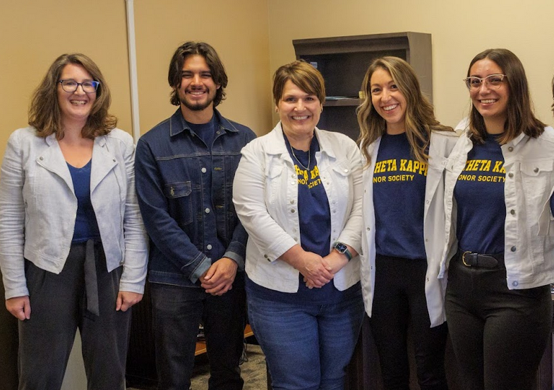
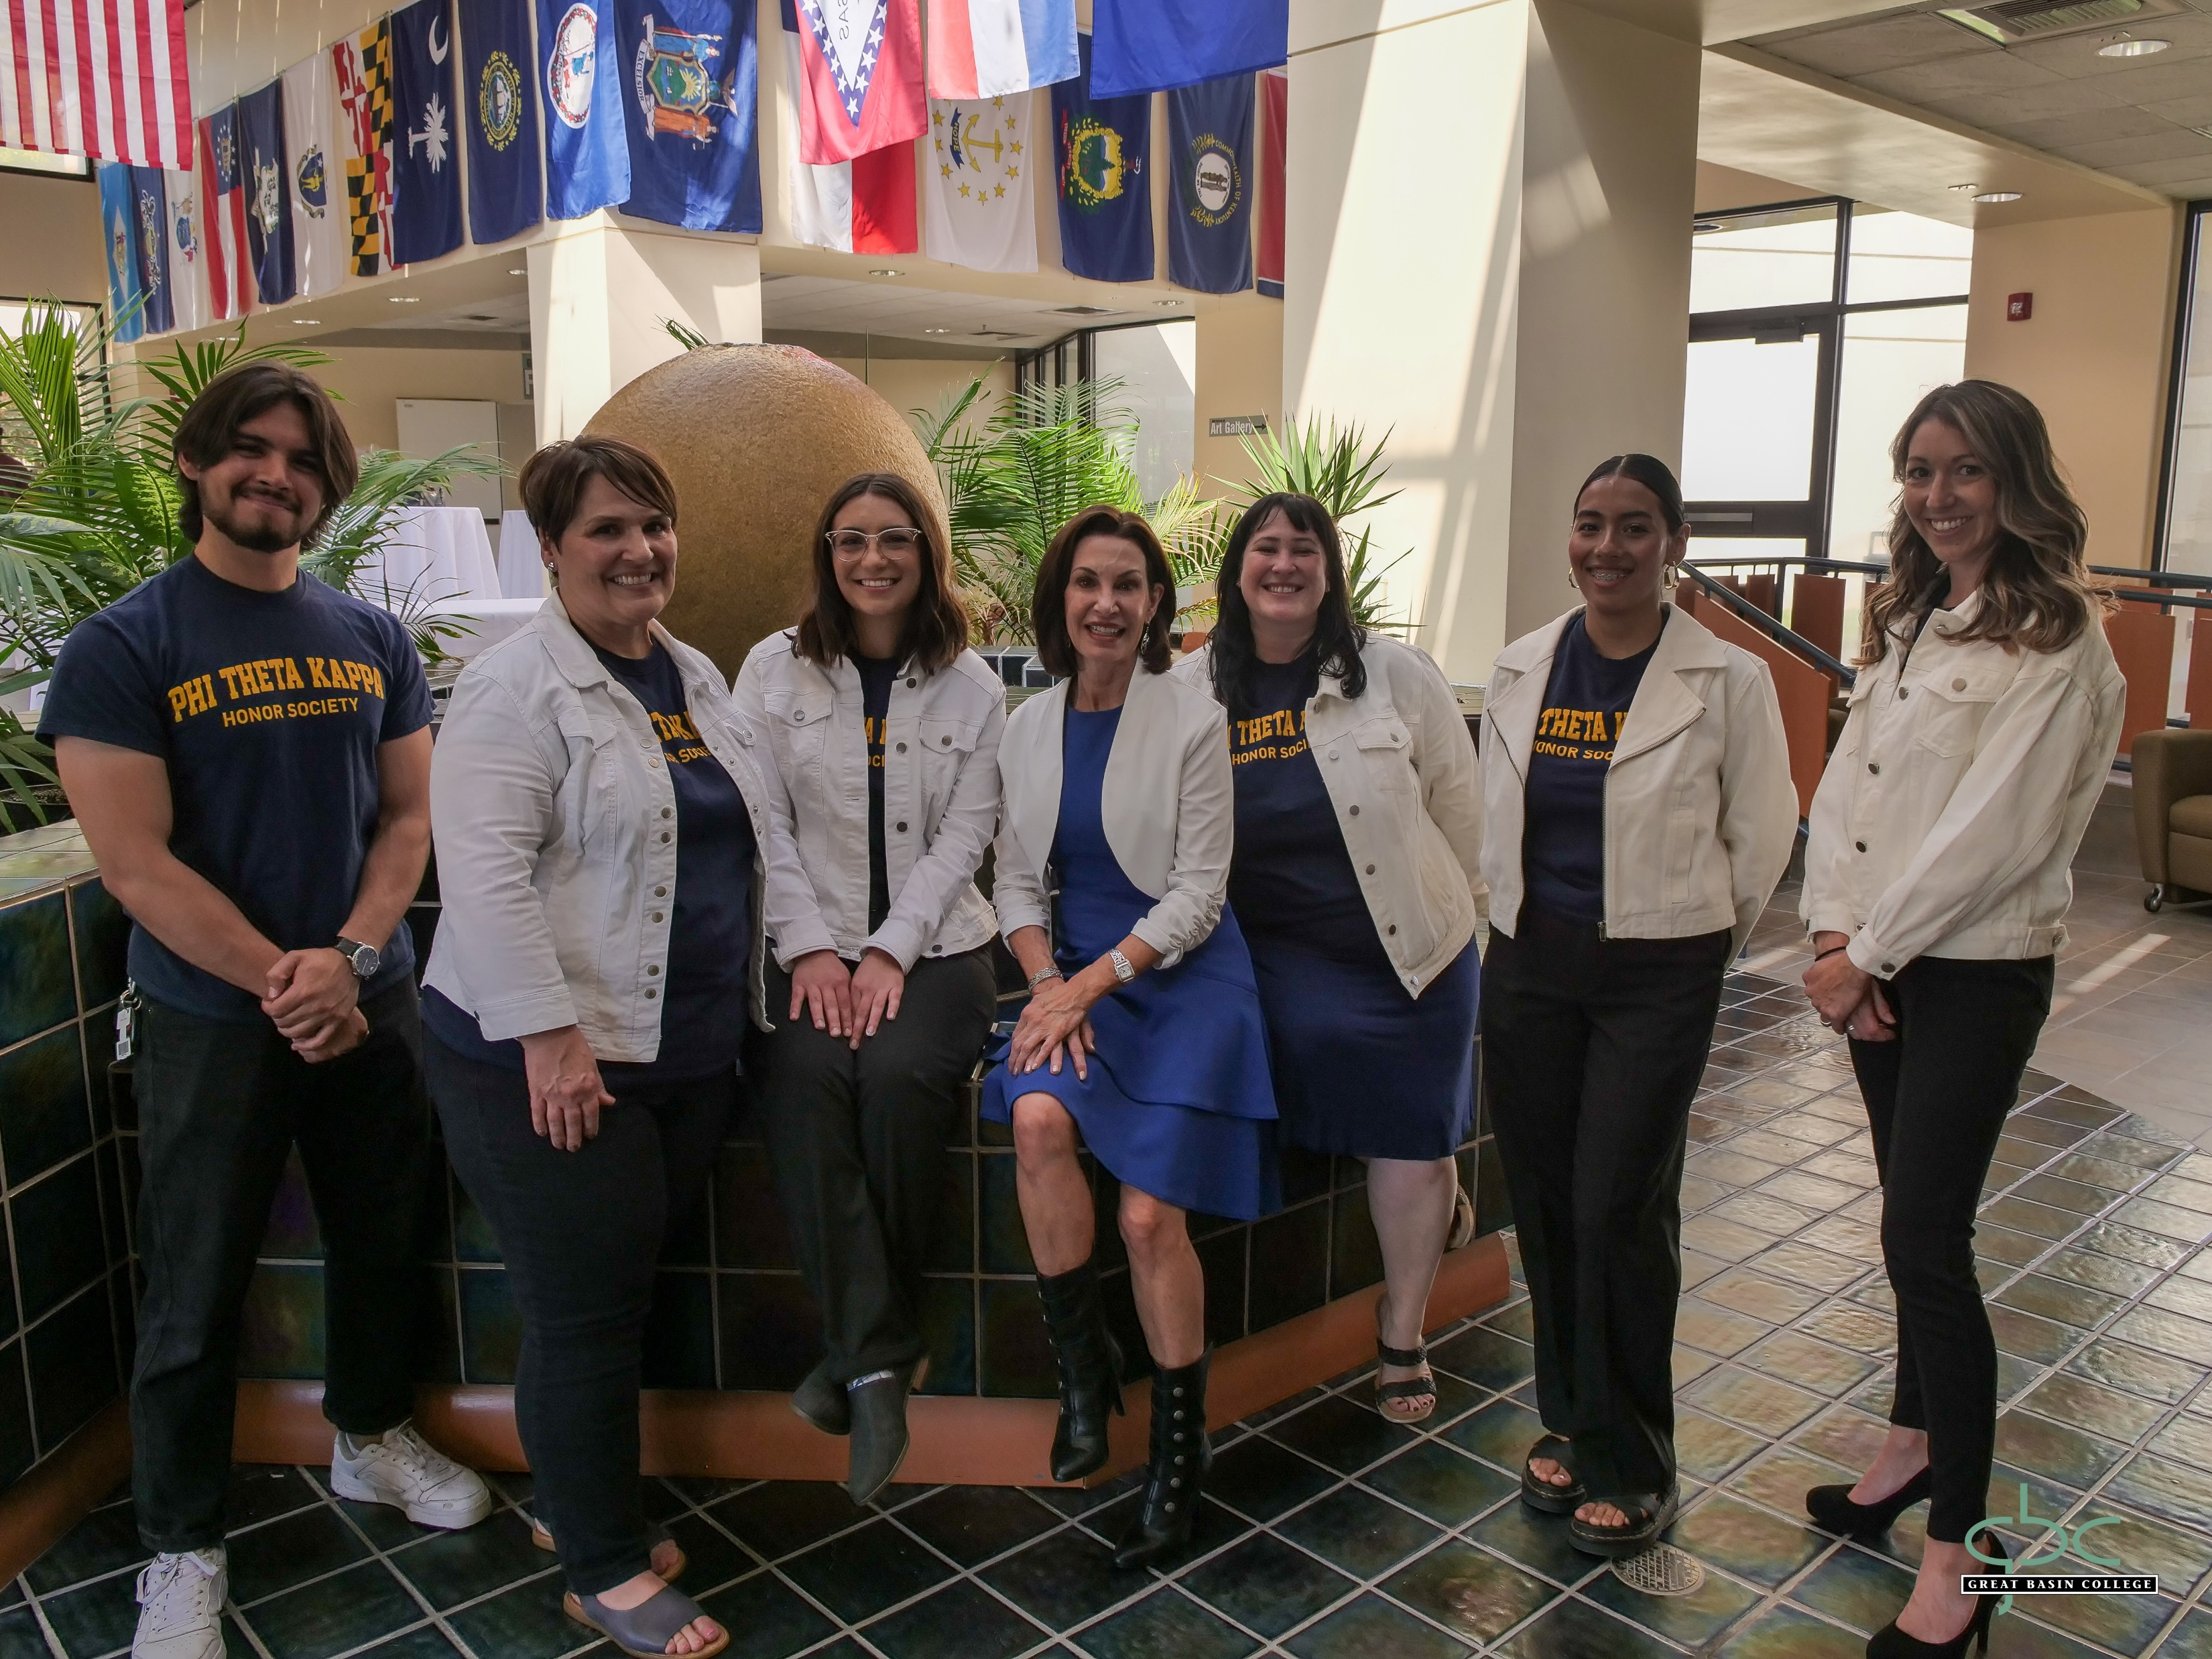
Great Basin College ~ Beta Beta Epsilon “You Matter” Foster Care Campaign, Fall 2022
Phi Theta Kappa Mission: The mission of Phi Theta Kappa is to recognize academic achievement of college students and to provide opportunities for them to grow as scholars and leaders.

Slide 3
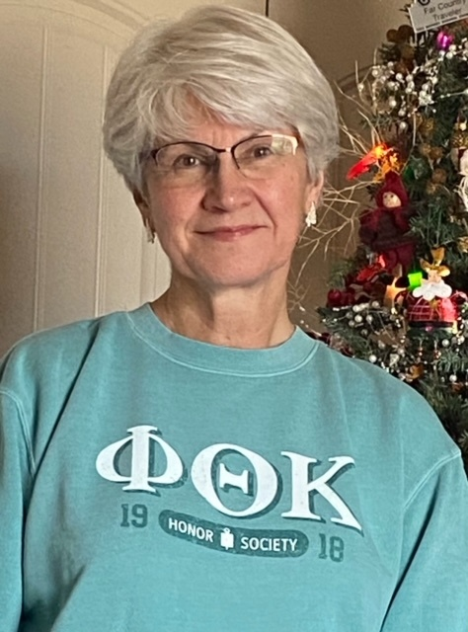
The “You Matter” Campaign Launched September 12, 2022
Phi Theta Kappa partnered with the Following entities:
Rural NV Department of Child & Family Services
Nye County Department of Child & Family Services
CASA: Court Appointed Advocates for Foster Children
GBC Student Government Association
Lakeshore Learning Materials
Nevada Early Intervention
GBC Social Work Program
GBC Classified Council
Nevada Gold Mines
The Phi Theta Kappa Officers met with President Helens and VP Rivera to seek support for the “You Matter” campaign in September 2022.
We received unconditional support!

Slide 4
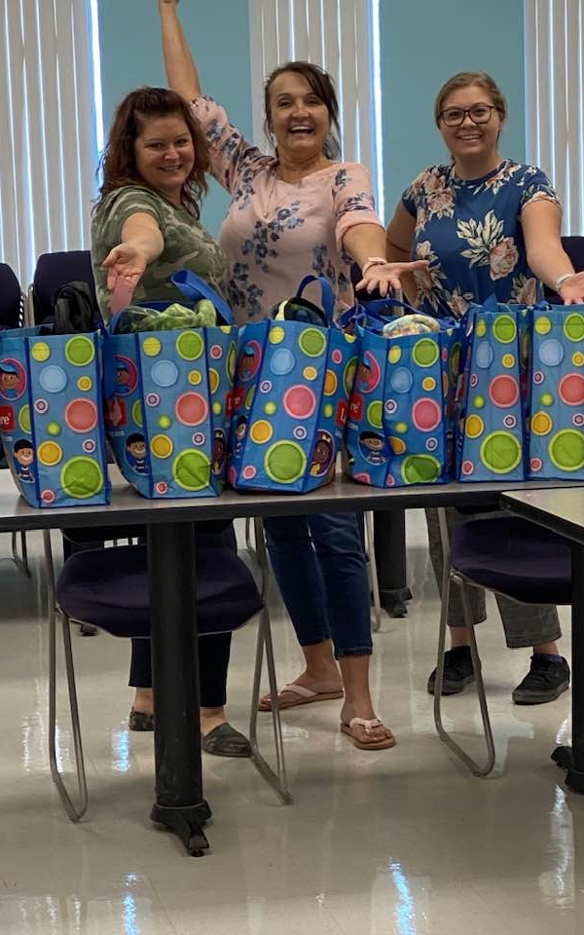
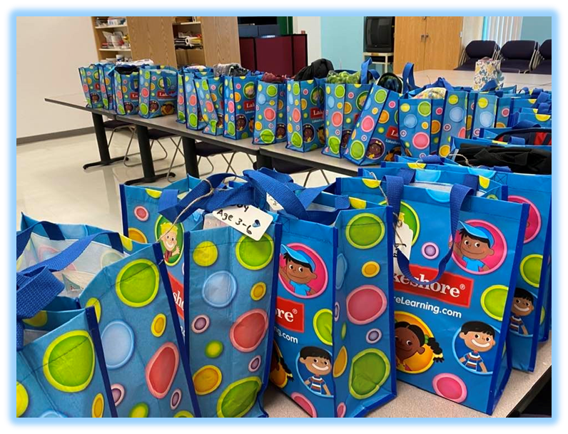
Gears of Generosity Synchronized Efforts Across GBC: Pahrump Site: “You Matter” – 39 Bags Phi Theta Kappa, the GBC Social Work Program, Classified Staff, and the GBC Education Department

Slide 5
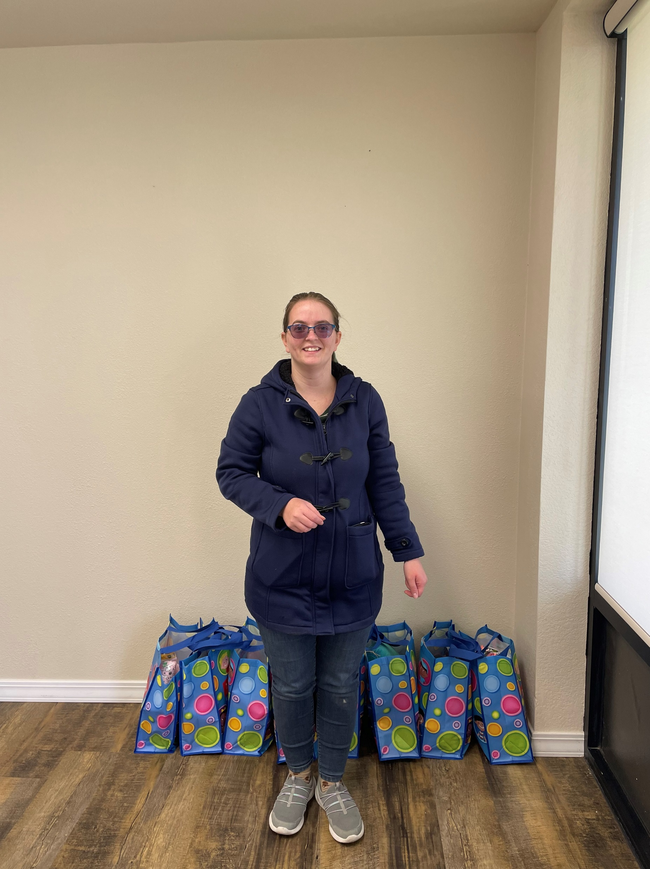
Winnemucca Site: “You Matter” – 84 Bags Phi Theta Kappa, Classified Staff, & Community Black Rock Vision Center, Nevada Gold Mines, and Battle Mountain Christ Lutheran Preschool

Slide 6
Winnemucca Site: “You Matter” – 84 Bags Phi Theta Kappa, Classified Staff, GBC Winnemucca Administration, Nevada Gold Mines, and Chrysler Dodge, Jeep, & Ram

Slide 7
Winnemucca Site: “You Matter” – 84 Bags Phi Theta Kappa, Classified Staff, Nevada Gold Mines, and REMAX Great Basin Reality

Slide 8
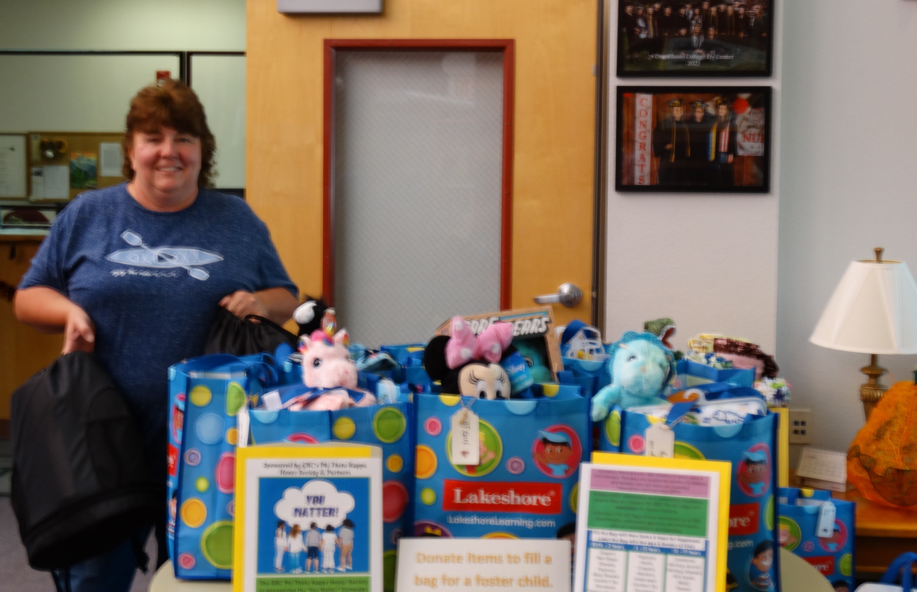
Ely Site: “You Matter” – 194 Bags Phi Theta Kappa, Classified Staff, Max & Cherie Reid, Lund High School & White Pine Library

Slide 9
Ely Site: “You Matter” – 194 Bags Phi Theta Kappa, Classified Staff, Ely DCFS, and Jared Russo, Social Work Student

Slide 10
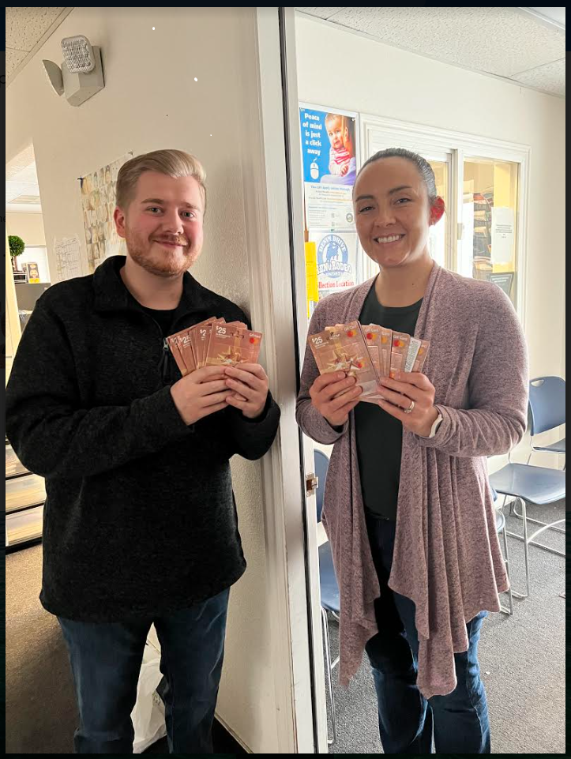
Ely Site: “You Matter” – 194 Bags Phi Theta Kappa, Classified Staff, & Robinson Mine Amanda Hilton, General Manager, Chelsea Nicholes, Human Resource Manager, Daisia Shed, Chief of Staff, and Jared Russo, Ely DCFS $4,265.00 in Cash Donations – Robinson Mine Payroll Deduction

Slide 11
Ely Site: “You Matter” – 194 Bags Phi Theta Kappa, Classified Staff, & Mt. Wheeler Power

Slide 12
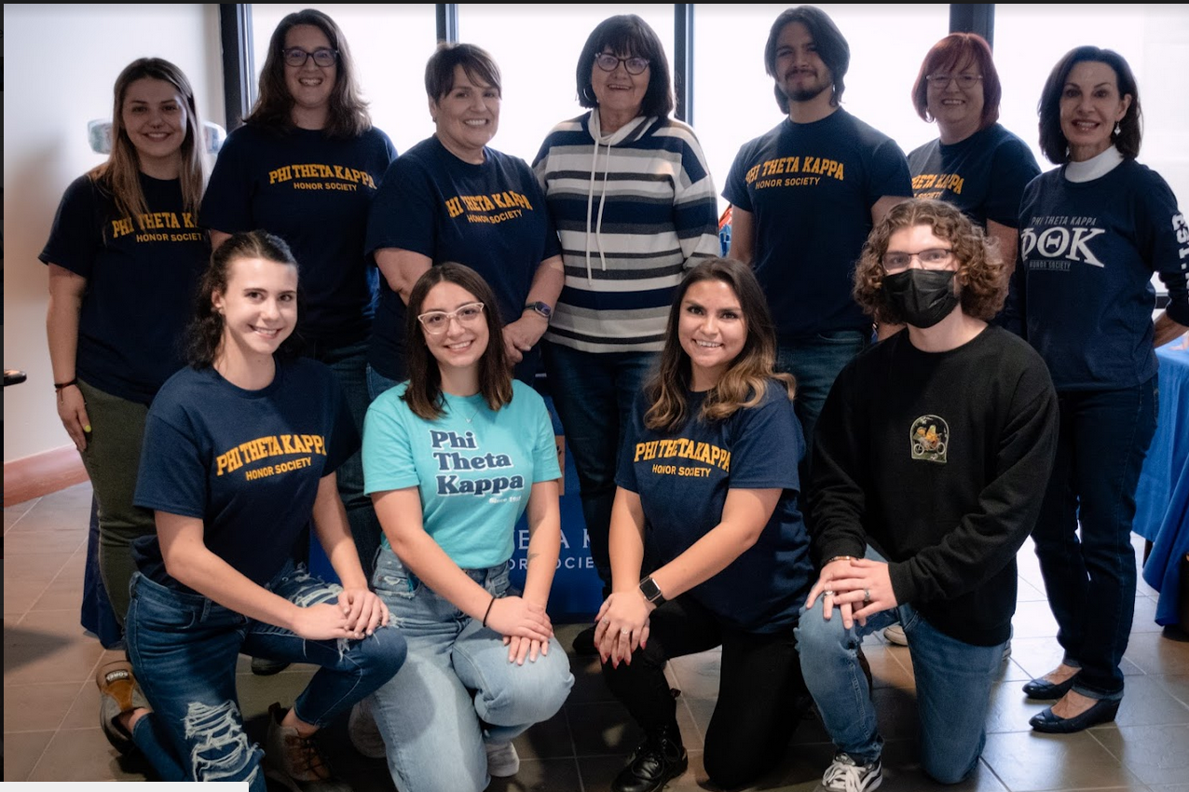
Elko: “You Matter” – 234 Bags Phi Theta Kappa, Classified Staff, Nevada Gold Mines, CASA, SGA, Elko County School District, Head Start of NE Nevada, GBC Child & Family Center, NV Fitness, GBC Administration, Faculty & Staff, and NSHE Regent, Cathy McAdoo

Slide 13
The Final Elko Push: November 16, 2022 Packing $5,000.00 Worth of Essential Items for Infants & Toddlers Donated by Nevada Gold Mines

Slide 14
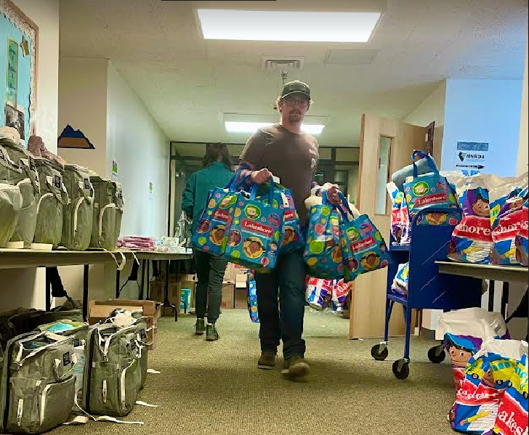
The Final Elko Push: November 16, 2022 Preparing for the delivery to the Department of Child & Family Services!

Slide 15
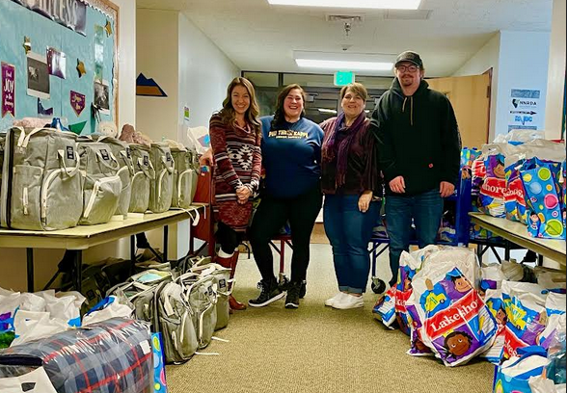
Final Inventory of Donated Items Total “You Matter” Bags Donated Campus-Wide: 551 Total Diaper Donations: 7,500+ ~ Total Cash Donations: $450.00 Total Items to Include Miscellaneous Donations: 12,400 & Total Gift Card Donations for Teens: $3,660.00

Slide 16
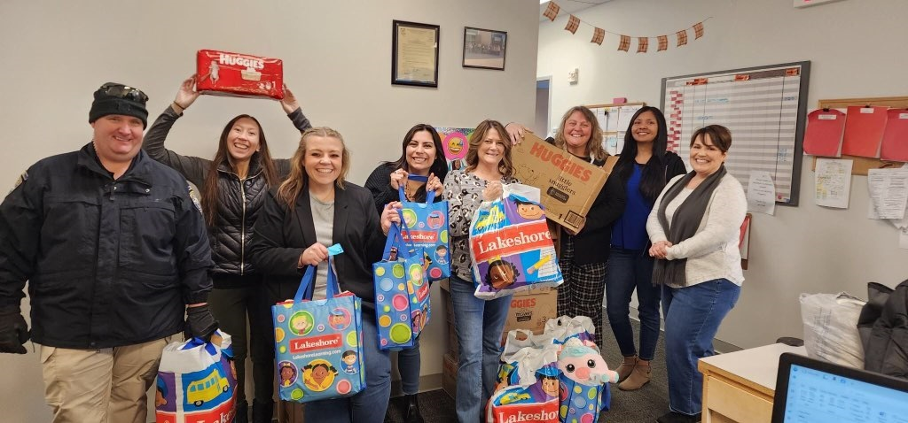
Final Delivery to Rural Nevada DCFS “To the world you may be one person, but to one person, you may be the world.”

Slide 17
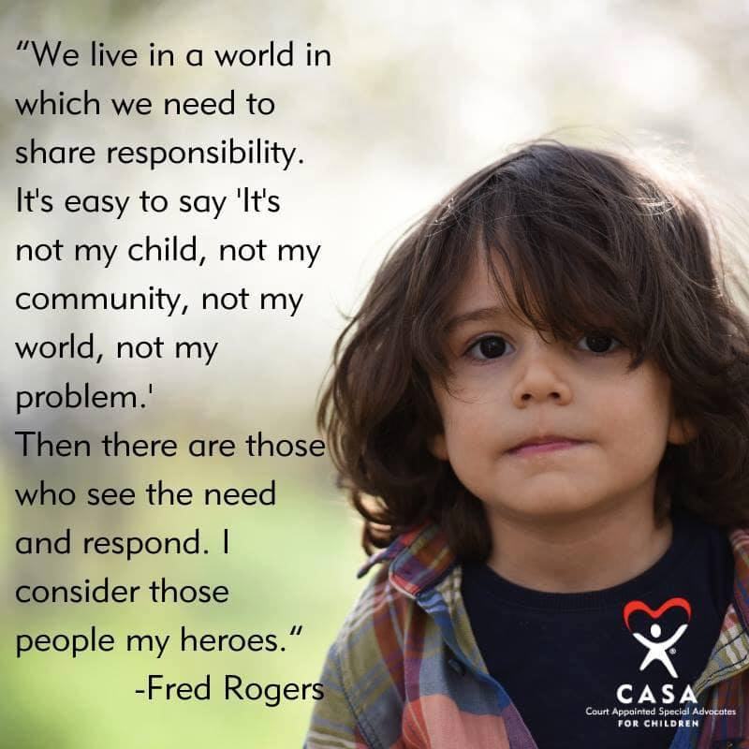
GBC Cares & We Are Aware! On behalf of Phi Theta Kappa, we send our heartfelt gratitude for your outstanding contributions to the “You Matter” Campaign.

